Slide 1
Diabetes Prediction​ Model​
Presented By: Harsha and Venkata Sesha Eleswarapu

Slide 2
Table of contents
01
03
02
04
03
05
Objective
Results
Data Source and Description
Monetary Value
Method
Risks and Benefits

Slide 3

Objective
The goal of this project is to develop a diagnostic prediction version that can forecast the chance of a patient having diabetes based on parameters in the dataset.​

Slide 4
The dataset used for this assignment is available on Kaggle and was obtained from the Behavioral Risk Factor Surveillance System (BRFSS). It is a health-related telephone survey that is collected annually by the CDC.​
Data Source

Slide 5
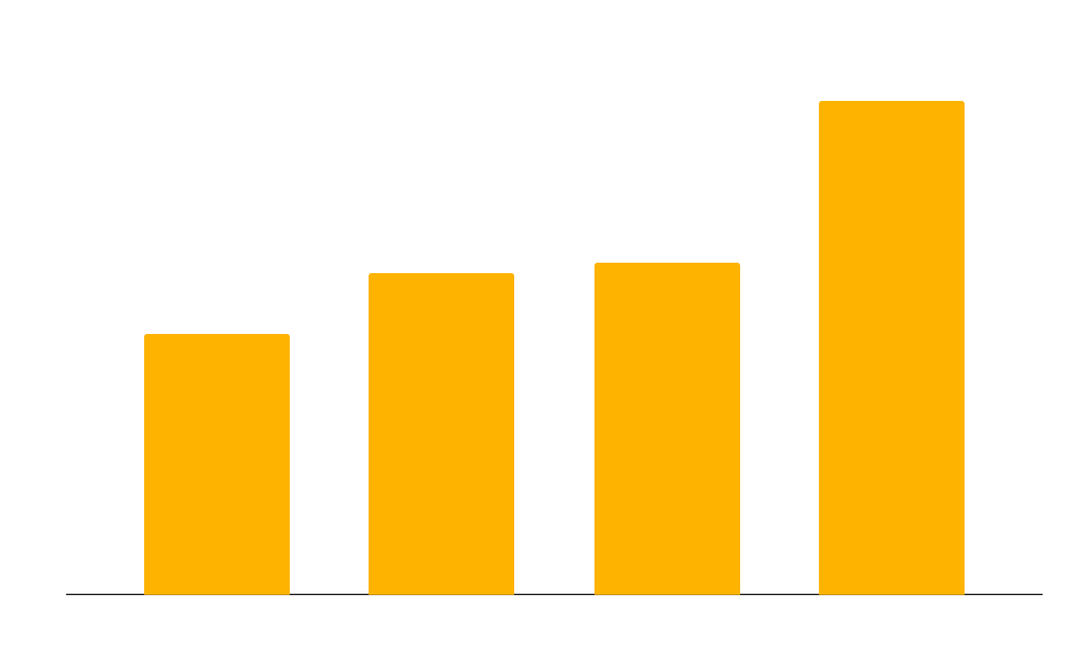
Data Description
It is a dataset of 253,680 survey responses to the CDC's BRFSS2015. The target variable Diabetes_012 has 3 classes. 0 is for no diabetes or only during pregnancy, 1 is for prediabetes, and 2 is for diabetes. There is class imbalance in this dataset.​
This dataset has 21 feature variables

Slide 6
Predictors
Predictors​ | Description​
HighBP​ | 0 = no high BP 1 = high BP​
HighChol​ | 0 = no high cholesterol 1 = high cholesterol​
CholCheck​ | 0 = no cholesterol check in 5 years 1 = yes cholesterol check in 5 years​
BMI​ | Body Mass Index​
Smoker​ | Have you smoked at least 100 cigarettes in your entire life? [Note: 5 packs = 100 cigarettes] 0 = no 1 = yes​
Stroke​ | (Ever told) you had a stroke. 0 = no 1 = yes​
HeartDiseaseorAttack​ | coronary heart disease (CHD) or myocardial infarction (MI) 0 = no 1 = yes​
PhysActivity​ | physical activity in past 30 days - not including job 0 = no 1 = yes​
Fruits​ | Consume Fruit 1 or more times per day 0 = no 1 = yes​
Veggies​ | Consume Vegetables 1 or more times per day 0 = no 1 = yes​
HvyAlcoholConsump​ | Heavy drinkers (adult men having more than 14 drinks per week and adult women having more than 7 drinks per week) 0 = no​

Slide 7
Predictors
Predictors​ | Description​
NoDocbcCost​ | Was there a time in the past 12 months when you needed to see a doctor but could not because of cost? 0 = no 1 = yes​
GenHlth​ | Would you say that in general your health is: scale 1-5; 1 = excellent 2 = very good 3 = good 4 = fair 5 = poor​
MentHlth​ | Now thinking about your mental health, which includes stress, depression, and problems with emotions, for how​
PhysHlth​ | Now thinking about your physical health, which includes physical illness and injury, for how many days during the past 30​
DiffWalk​ | Do you have serious difficulty walking or climbing stairs? 0 = no 1 = yes​
Sex​ | 0 = female 1 = male​
Age​ | 13-level age category; 1 = 18-24 9 = 60-64 13 = 80 or older​
Education​ | Education level; scale 1-6; 1 = Never attended school or only kindergarten 2 = Grades 1 through 8​
Income​ | Income scale; scale 1-8; 1 = less than $10,000 5 = less than $35,000 8 = $75,000 or more​

Slide 8
Method
We analyzed cross-sectional data of 253,680 survey responses to the CDC's BRFSS2015. We built multiple machine learning models for predicting diabetes based on diagnostic parameters in the dataset, including logistic regression, random forest, decision tree, Gradient boosting and XG Boost.​

Slide 9
Results
The Decision Tree model showed the highest ROC AUC score on the training data (0.90), suggesting potential overfitting as its test score was only 0.62. Logistic Regression performed best on the test data (0.73 AUC score), indicating good model generalizability. All models were more successful at predicting class 0 (no diabetes), implying a possible class imbalance in our dataset. Gathering more data for under-represented classes could improve model performance. The XG Boost model performed the least effectively, suggesting the need for hyperparameter tuning or replacement with better-performing models.
Git hub link: https://github.com/VenkataEleswarapu/Diabetes_prediction_project

Slide 10
Monetary Value: Business Perspective​
Market Size: According to the American Diabetes Association, over 34 million people in the United States have diabetes, and approximately 88 million adults have prediabetes. If we consider the market of people who could potentially use a diabetes prediction application, it's quite large.​
Pricing Model: The revenue generated will depend on the pricing model. If it's a subscription-based model, for example, $10/month, and if you can capture 1% of the prediabetes market (880,000 people), that's $8.8 million per month or $105.6 million per year.​
Partnerships with Healthcare Providers: If the application is sold or licensed to healthcare providers or insurance companies, the revenue could be significantly higher. For example, if 1000 healthcare providers pay $10,000 per year to license the software, that's an additional $10 million per year.​

Slide 11
Monetary Value: People Perspective
Cost of Diabetes Management: According to the American Diabetes Association, the average annual medical expenditure for people with diagnosed diabetes is about $16,750 per year, of which about $9,600 is attributed to diabetes.​
​
If the application helps 1% of the 88 million prediabetic adults in the U.S. prevent diabetes, that's 880,000 people. If each of these people avoids $9,600 in medical costs per year, the total savings would be over $8.4 billion per year.​

Slide 12
Risks
Accuracy of Predictions: The effectiveness of the application depends on the accuracy of its predictions. If the model has a high rate of false positives or negatives, it could lead to unnecessary treatments or missed diagnoses.​
Data Privacy: The application requires access to sensitive health data. There are strict regulations around the use and storage of such data, and breaches can lead to significant financial penalties.​
Ethical Considerations: There are ethical considerations around the use of predictive health models. For example, if an individual is predicted to develop diabetes, this could potentially impact their ability to get life or health insurance.​
Reliance on the Model: There's a risk that healthcare providers or individuals may rely too heavily on the model, potentially overlooking other important health indicators or symptoms.​

Slide 13
Benefits
Personalized Treatment Plans: With early prediction, healthcare providers can develop personalized treatment plans that can help manage the disease more effectively, leading to improved patient outcomes.​
Lifestyle Changes: Individuals who are predicted to develop diabetes can make lifestyle changes to prevent or delay the onset of the disease. This can lead to improved health and quality of life.​
Research Opportunities: The data collected and analyzed by the model can provide valuable insights for researchers studying diabetes.​

Slide 14
Thank
You!

